Slide 1











INDEV
India’s Newest Direct Ecommerce Vendor

Slide 2
Project Profile
Header | Text
Project Title | INDEV
Project Definition | Ecommerce Website
Project Type | Web Based Application
Developed By | Jaspreet Singh Raval Viraj Shaikh Sahil
Frontend Tool | Microsoft Visual Studio Code 2024
Backend Tool | Python Django Localhost Server
Database | SQlite

Slide 3
Identification of Problem and Proposing a Solution

Slide 4
Problems Within Existing System
1. Limited Reach – Many platforms struggle to serve Tier 2 & Tier 3 cities, leaving a large customer base underserved.
2. Time-Consuming Process – Lengthy product searches, checkout delays, and slow deliveries make shopping inefficient.
3. High Manpower Requirements – Traditional commerce models require extensive workforce management for sellers, logistics, and customer support.
4. Increased Product Prices – Middlemen and commissions drive up costs, making products more expensive for consumers.
5. Resource-Intensive Operations – Managing multiple sellers, warehouses, and logistics networks leads to higher operational costs.

Slide 5
Need For New System
1. Wider Reach – A direct vendor model ensures seamless access to Tier 2 & Tier 3 cities, expanding market coverage.
2. Faster Shopping & Delivery – Eliminating middlemen streamlines processes, reducing delays in order fulfillment.
3. Reduced Manpower Costs – Automating order processing, logistics, and customer support lowers operational workforce dependency.
4. Lower Product Prices – Direct sourcing from manufacturers minimizes extra charges, making products more affordable.
5. Efficient Resource Utilization – Optimized inventory and logistics management cut down unnecessary resource consumption.

Slide 6
Proposed New System - INDEV
INDEV is a multi-vendor, multi-buyer eCommerce platform that connects sellers directly with consumers, eliminating middlemen to ensure affordable pricing, buyer & seller authenticity.
Key Features of the Proposed System :-
1. Multi-Vendor System – Allows multiple vendors to list and sell products directly, ensuring authenticity and competitive pricing.
2. Multi-Buyer System – Supports multiple customers simultaneously with a seamless shopping experience.
3. Product Listing – Vendors can easily upload product details, images, and pricing.
4. Placing Orders – Customers can browse, add items to the cart, and place orders for one or multiple products simultaneously.
5. Delivery Tracking System – Real-time shipment tracking keeps customers updated on order status.

Slide 7
INDEV – INDIA’S NEWEST DIRECT ECOMMERCE VENDOR
INDEV – INDEV is an Acronym
I – India’s : Focused on transforming India’s eCommerce landscape.
N – Newest : A fresh, innovative platform redefining online shopping.
D – Direct : Eliminates middlemen for better pricing and authenticity.
E – E-commerce : A seamless digital marketplace for diverse products.
V – Vendor : Connecting consumers directly to trusted brands.
Introduction to INDEV
What is INDEV?
A direct eCommerce platform offering a seamless shopping experience.
Eliminates middlemen to ensure better pricing and transparency.
Why INDEV?
Because the name easily convey the meaning and its purpose.
It has a flare of patriotism to it.

Slide 8
Pre-Development Requisites and Post-Development Requirements

Slide 9
Pre-Development Requisites
Hardware
Software
1. Device : Desktop, Laptop
2. Processor : 2.5 GHZ +
3. RAM : At least 8GB RAM (16GB recommended for better performance)
4. Storage : 10 GB of free space (for media files)
1. Operating System : Windows, macOS, Linux
2. Browser Support : Chrome, Edge , etc (latest versions)
3. Development Environment : Python and its modules
Pip
Virtualenv
Django
Pillow
4. Software : Visual Studio Code (latest version)

Slide 10
Post-Dev Hardware Requirements
Client SIde
Server Side
1. Device : Desktop, Laptop
2. Processor : 2.0 GHZ +
3. RAM : At least 4GB RAM (8GB recommended for better performance)
4. Storage : 1 GB of free space (for browser cache)
1. Device : Desktop, Laptop
2. Processor : 2.5 GHZ +
3. RAM : At least 8GB RAM (16GB recommended for better performance)
4. Storage : 10 GB of free space (for media files)

Slide 11
Post-Dev Software Requirements
Client SIde
Server Side
1. Operating System : Windows, macOS, Linux
2. Browser Support : Chrome, Edge , etc (latest versions)
1. Operating System : Windows, macOS, Linux
2. Browser Support : Chrome, Edge , etc (latest versions)
3. Server Support : Python Django Localhost
4. Database Support : Python Django Sqlite

Slide 12
The Three Category of Users And Their Roles

Slide 13
Admin Category and Roles
ROLE | ADMIN
1. | Login
2. | Superuser
3. | Add New Category
4. | Update Order Status

Slide 14
Buyer Category and Roles
ROLE | BUYER
1. | Register/Login
2. | View All Products, Shops and Categories View Their Cart and Orders
3. | Add Remove Products in Cart Increase Decrease Quantity in Cart
4. | Create Order Cancel Placed Order and Delete Delivered Order

Slide 15
Seller Category and Roles
ROLE | SELLER
1. | Register/Login
2. | View Their Products, Categories and Orders
3. | Add Product, Update Stock and Delete Product
4. | Accept or Reject Order

Slide 16
Data Flow Diagram

Slide 17
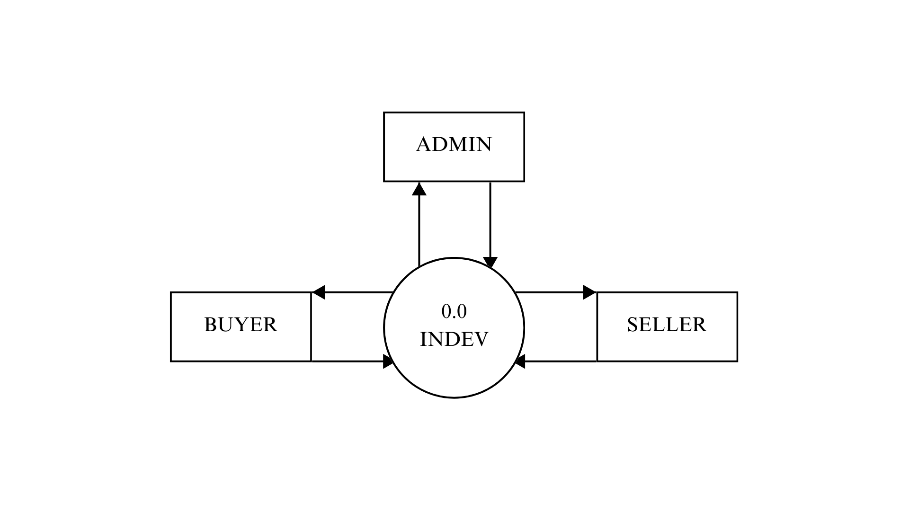
Context Level DFD
Response
Request
Response
Response
Request
Request

Slide 18
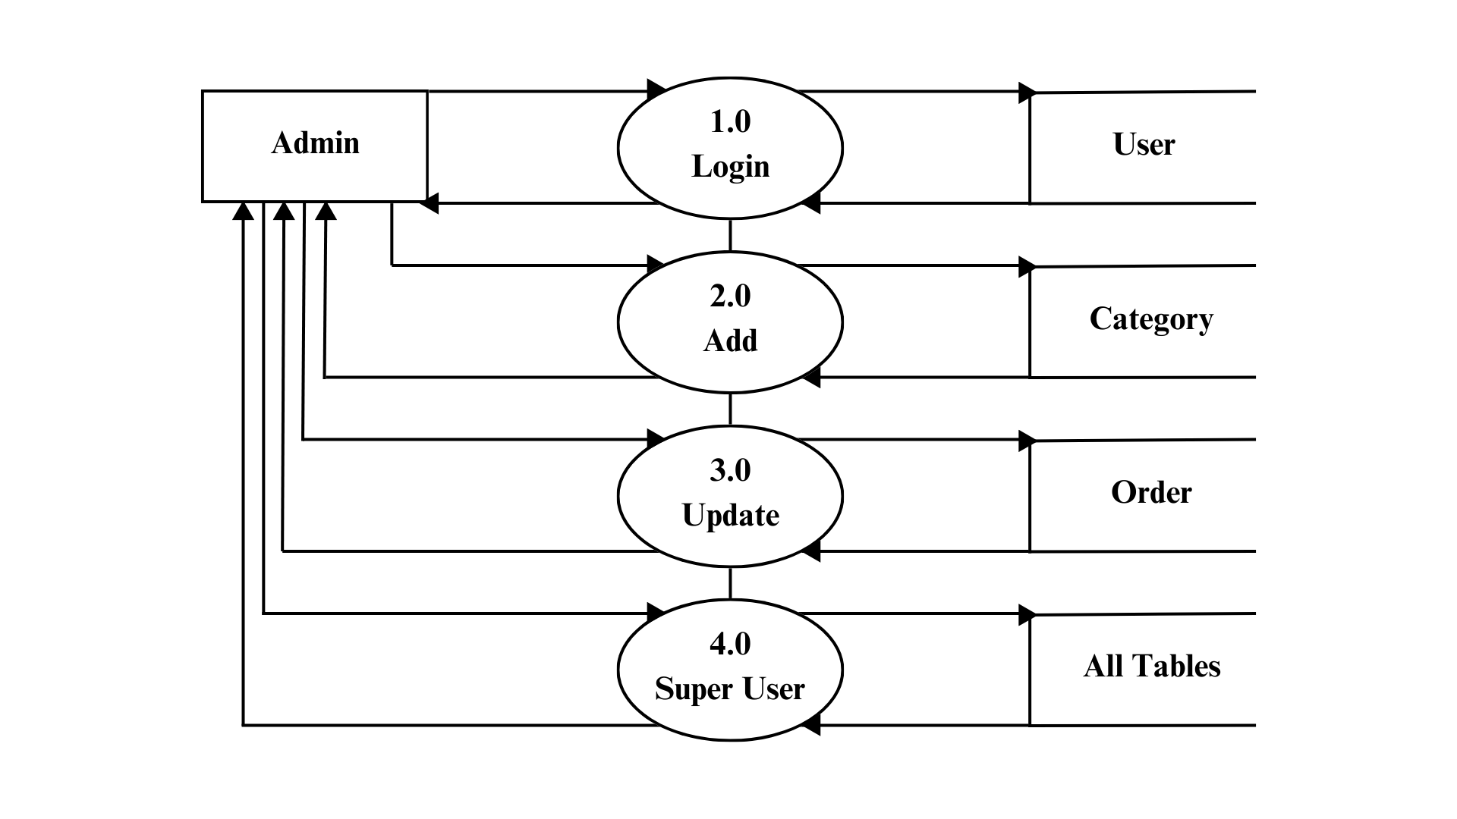
Admin Level DFD
Login Details
Login Details
Response
Response
Add
Add
Response
Response
Update
Update
Response
Response
Manage
Manage
Response
Response

Slide 19
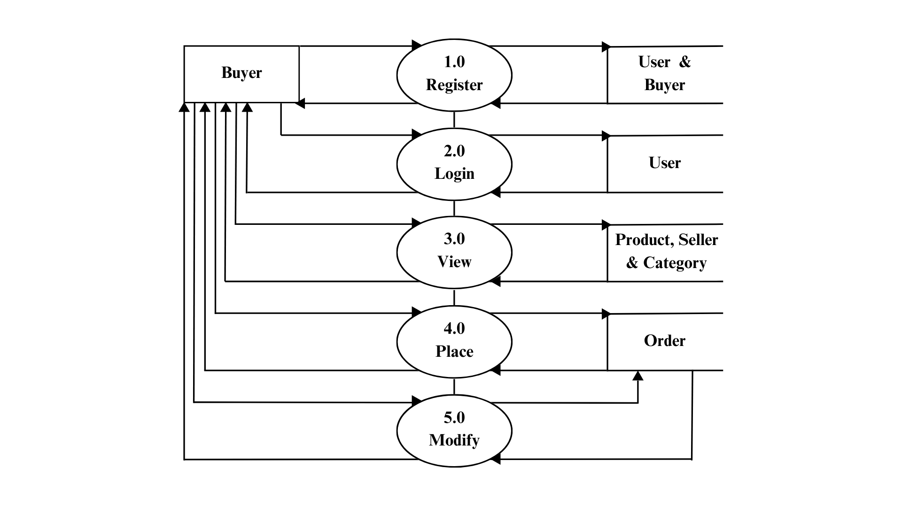
Buyer Level DFD
Register
Register
Response
Response
Details
Details
Response
Response
View
View
Response
Response
Cart & Checkout
Place
Response
Response
Cancel & Delete
Cancel & Delete
Response
Response

Slide 20
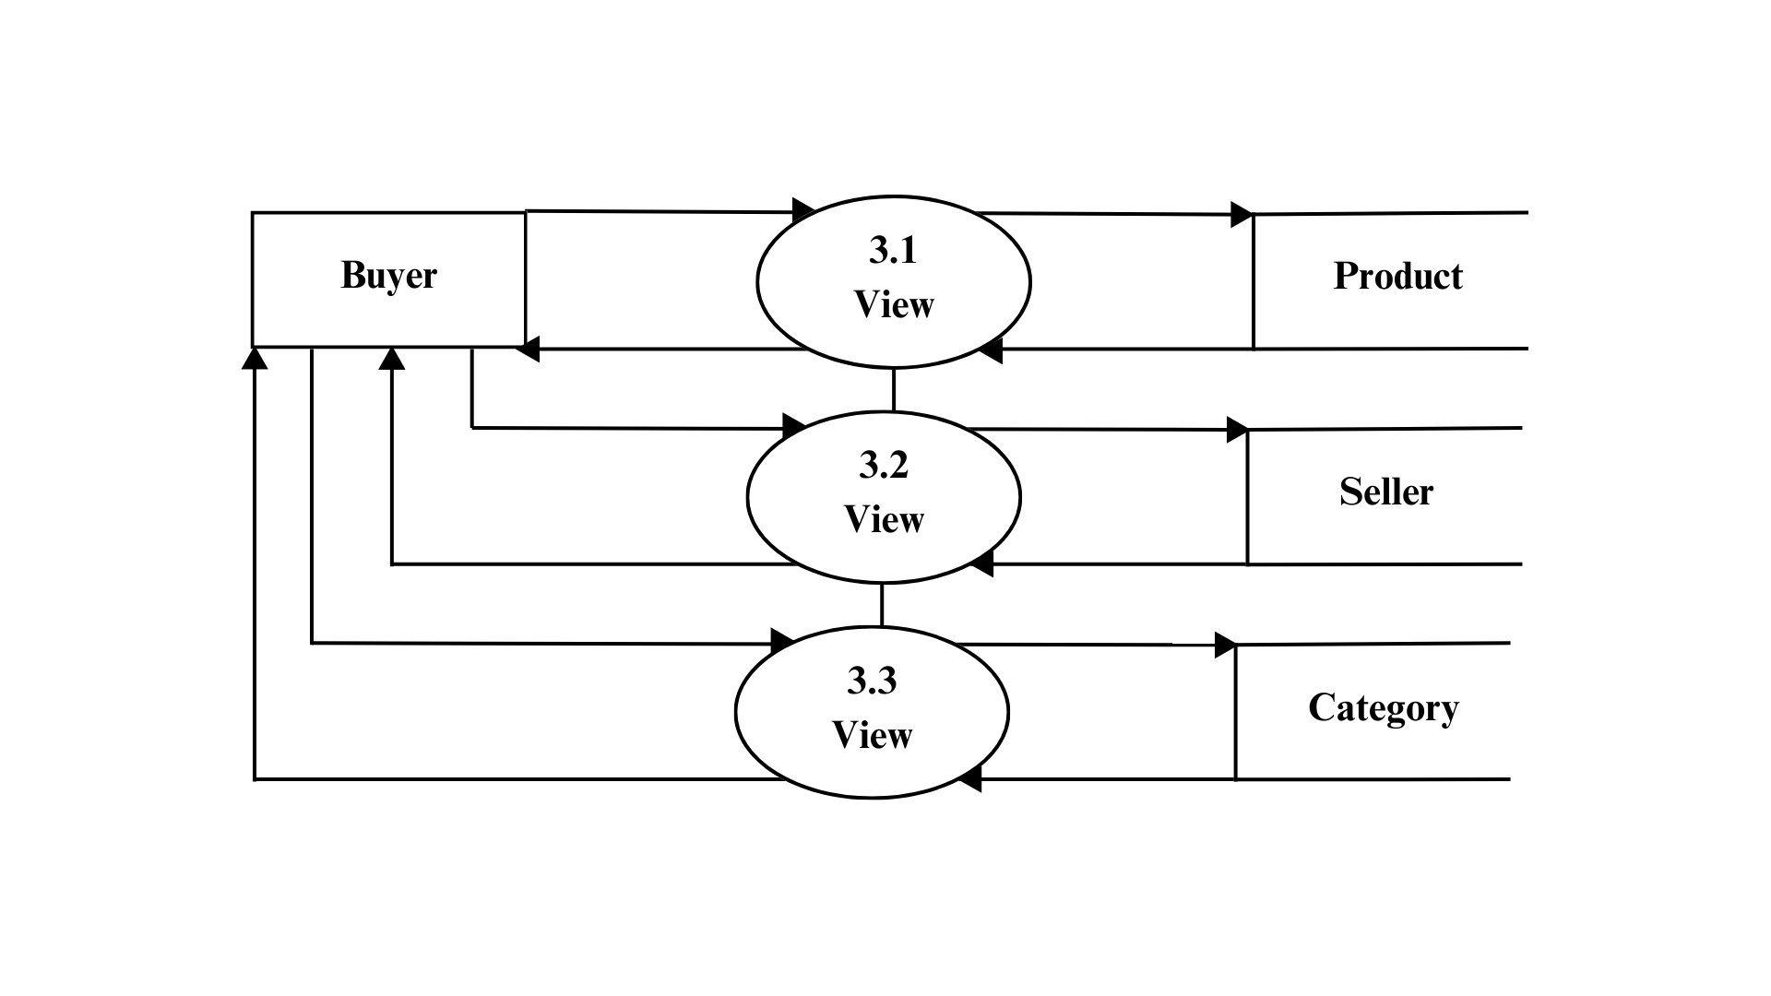
Buyer Level 3.1 DFD
View
View
Response
Response
View
View
Response
Response
View
View
Response
Response

Slide 21
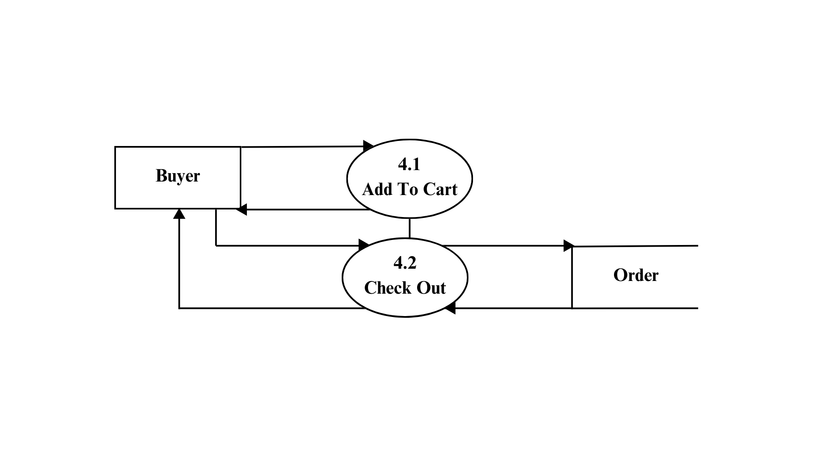
Buyer Level 4.1 DFD
Add To Cart
Response
Check Out
Check Out
Response
Response

Slide 22
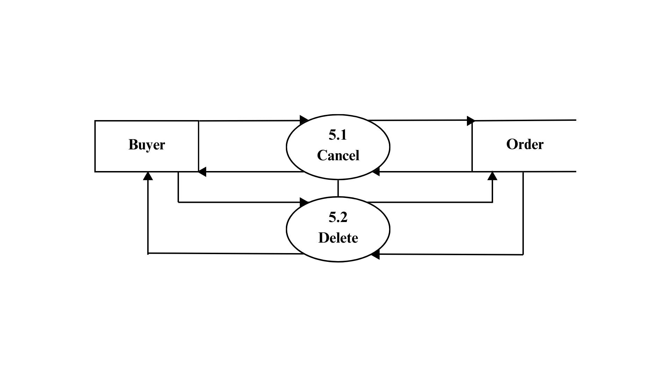
Buyer Level 5.1 DFD
Cancel Order
Cancel Order
Response
Response
Delete Order
Delete Order
Response
Response

Slide 23
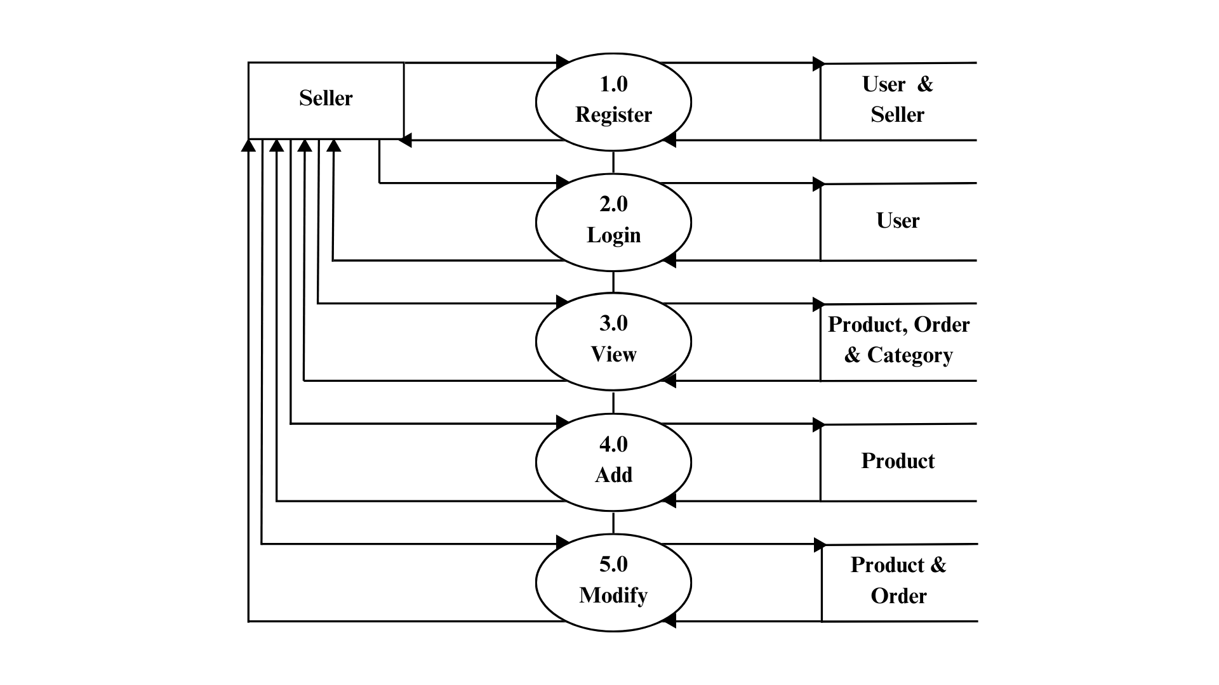
Seller Level DFD
Register
Register
Response
Response
Details
Details
Response
Response
View
View
Response
Response
Add
Add
Response
Response
Modify
Modify
Response
Response

Slide 24
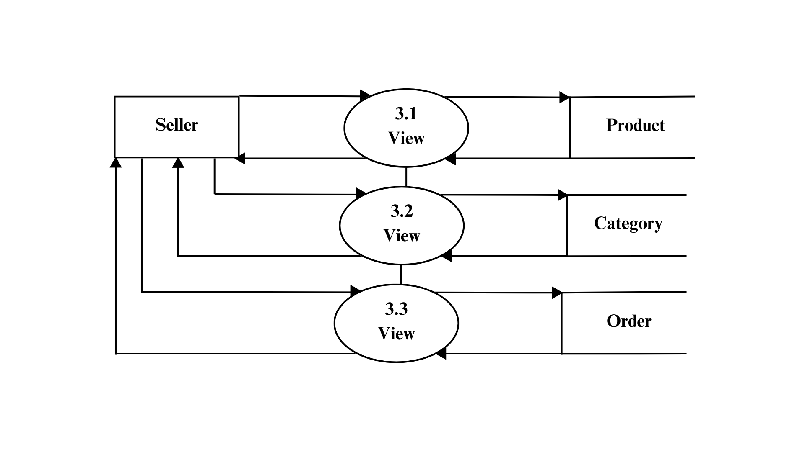
Seller Level 3.1 DFD
View
View
Response
Response
View
View
Response
Response
View
View
Response
Response

Slide 25
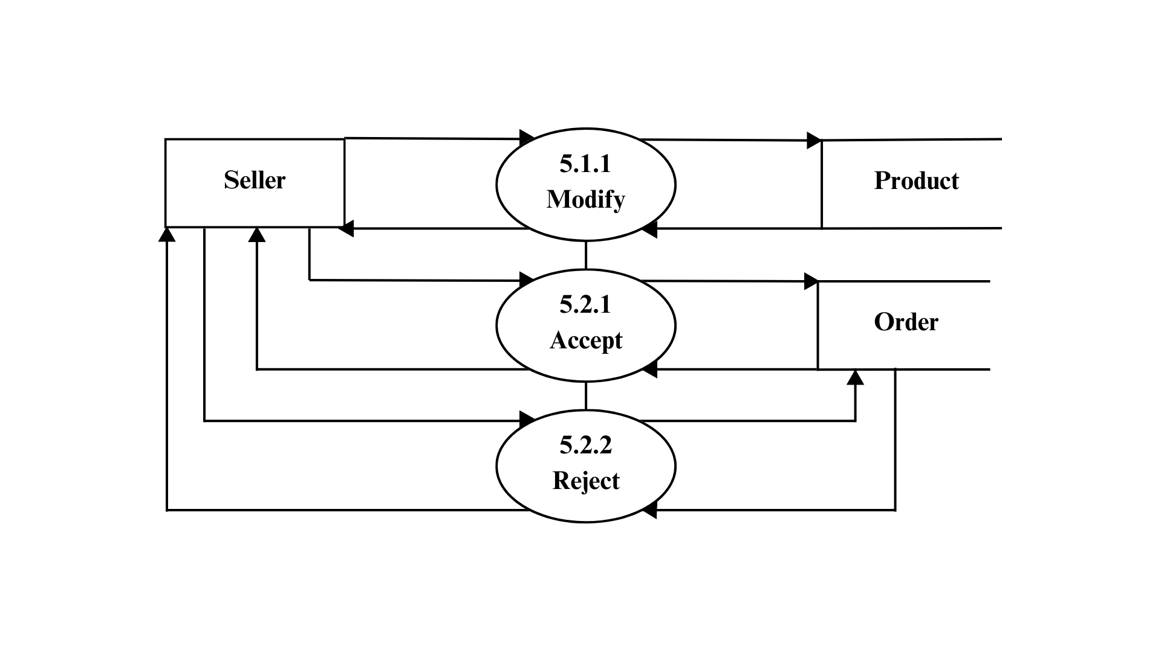
Seller Level 5.1 DFD
Modify Products
Modify Products
Response
Response
Accept
Accept
Response
Response
Reject
Reject
Response
Response

Slide 26
Entity Relationship Diagram

Slide 28
Data Dictionary

Slide 29
Default Users Model
Attributes | Data Type | Constraints | For Example
ID | Integer Auto Field | Primary Key , Auto Increment | 1
Username | Character Field(150) | Unique , Not Null | admin
Password | Character Field(128) | Not Null , PBKDF2 with SHA-256 | Hashed(‘S@hil0209’)
First Name | Character Field(150) | Not Null , Default=‘’ | ADMIN
Staff Status | Boolean Field | Not Null , Default=False | True

Slide 30
Buyer Model
Attributes | Data Type | Constraints | For Example
ID | Integer Auto Field | Primary Key , Auto Increment | 1
New_User | Foreign Key(Users) | Unique , Not Null | Users(2)
First_Name | Character Field(50) | Not Null | Sahil
Last_Name | Character Field(50) | Not Null | Shaikh
Email | Email Field(50) | Not Null | sahil@gmail.com
Date | Date Field | Not Null | 02-09-2003
Gender | Character Field(10) | Not Null | Male
Aadhaar | Character Field(12) | Not Null | 111122223333
Contact | Character Field(10) | Not Null | 9999988888
Address | Text Field(400) | Not Null | Mehsana

Slide 31
Seller Model
Attributes | Data Type | Constraints | For Example
ID | Integer Auto Field | Primary Key , Auto Increment | 1
New_User | Foreign Key(Users) | Unique , Not Null | Users(3)
Seller_Name | Character Field(50) | Not Null | Samsung
Seller_Description | Character Field(50) | Not Null | We Sell Mobiles
Logo | Image Field | Upload To , Not Null | ‘shops/logo/1.png’
Banner | Image Field | Upload To , Not Null | ‘shops/banner/1.png’
GSTIN | Character Field(15) | Not Null | 111112222233333
Email | Email Field(100) | Not Null | sahil@gmail.com
Contact | Character Field(10) | Not Null | 9999988888
Address | Text Field(400) | Not Null | Mehsana

Slide 32
Category Model
Attributes | Data Type | Constraints | For Example
ID | Integer Auto Field | Primary Key , Auto Increment | 1
Category_Name | Character Field(50) | Not Null | Mobiles
Category_Description | Character Field(50) | Not Null | For Example Phones
Category_Icon | Image Field | Upload To , Not Null | ‘cat/icon/1.png’
Category_Banner | Image Field | Upload To , Not Null | ‘cat/banner/1.png’

Slide 33
Product Model
Attributes | Data Type | Constraints | For Example
ID | Integer Auto Field | Primary Key , Auto Increment | 1
Seller_Name | Foreign Key(Seller) | Not Null | Seller(1)
Product_Name | Character Field(50) | Not Null | Jio Phone
Product_Desc | Character Field(50) | Not Null | It is a Phone
Product_Price | Integer Field | Not Null | 1000
Product_Img | Image Field | Upload To , Not Null | ‘Products/1.png’
Product_Status | Character Field(50) | Choices , Default , Not Null | In Stock
Category_Name | Foreign Key(Category) | Not Null | Category(1)

Slide 34
Order Model
Attributes | Data Type | Constraints | For Example
ID | Integer Auto Field | Primary Key , Auto Increment | 1
Buyer_ID | Foreign Key(Buyer) | Not Null | Buyer(1)
Seller_ID | Foreign Key(Seller) | Not Null | Seller(1)
Product_ID | Foreign Key(Product) | Not Null | Product(1)
Product_Quantity | Integer Field | Not Null | 5
Product_Total | Integer Field | Not Null | 5
Order_Status | Character Field(50) | Choices , Default , Not Null | Order Placed

Slide 35
Contact Request Model
Attributes | Data Type | Constraints | For Example
ID | Integer Auto Field | Primary Key , Auto Increment | 1
Email | Email Field(50) | Not Null | sahil@gmail.com
Purpose | Character Field(500) | Not Null | Appointment

Slide 36
Feedback Model
Attributes | Data Type | Constraints | For Example
ID | Integer Auto Field | Primary Key , Auto Increment | 1
Email | Email Field(50) | Not Null | sahil@gmail.com
Feedback | Character Field(500) | Not Null | Good Work

Slide 37
Technologies Used From Django Framework

Slide 38
Technologies Used
1. Template Management and Template Inheritance – Django framework provides in itself the feature of template management and also provides support for inheritance of one template into another.
2. Static Files and Media Files – Django framework also provides its efficient method of managing static files and media files by creating root directories.
3. Django Localhost Server – Django framework provides its own local server for testing and hosting the website for development and debugging.
4. Default User Model – Django framework provides a default user model which used to the store data of all type of users.
5. Django Authentication – Django framework provides predefined function of Authenticate, Login and Logout which can be used to perform authentication of a user , it’s login and logout activities.

Slide 39
Technologies Used – Continued
6. Dynamic Url Routing – Django framework provides support to create and use dynamic urls for routing to webpages.
7. CSRF Token – CSRF stands for Cross Site Request Forgery , Django framework in all its forms uses a csrf token to ensure the integrity of the data passing via forms.
8. Django ORM – ORM stands for Object-Relational Mapping, Django framework uses object relational mapping to map each object member of a class as a field in the database. It provides easy, fast and efficient controls. We can fetch records faster.
9. Django Admin Interface – Django framework provides a default admin interface which can be used to create admins and super-admins. Admins are those with staff privileges and super-admins have all privileges of all tables.
10. Easy Integration with Other Python Modules – Django itself being a python module, it allows seamless integration with other python modules such as pillow and csv for better functionality in the overall projects.

Slide 40
Guest Side
Input Design

Slide 41
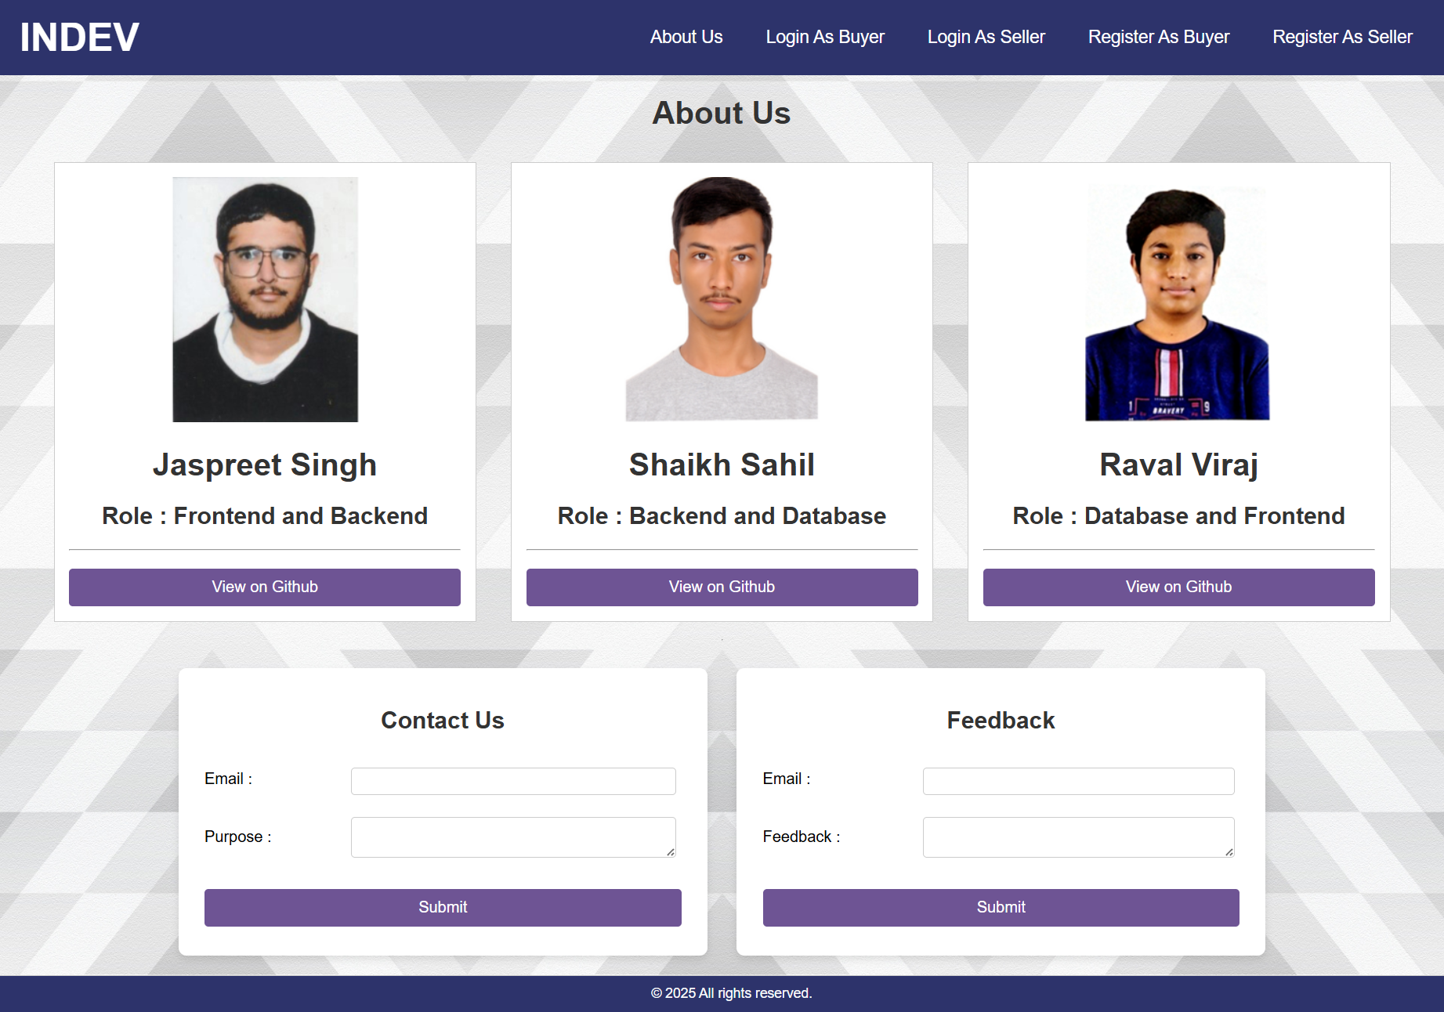

Slide 42
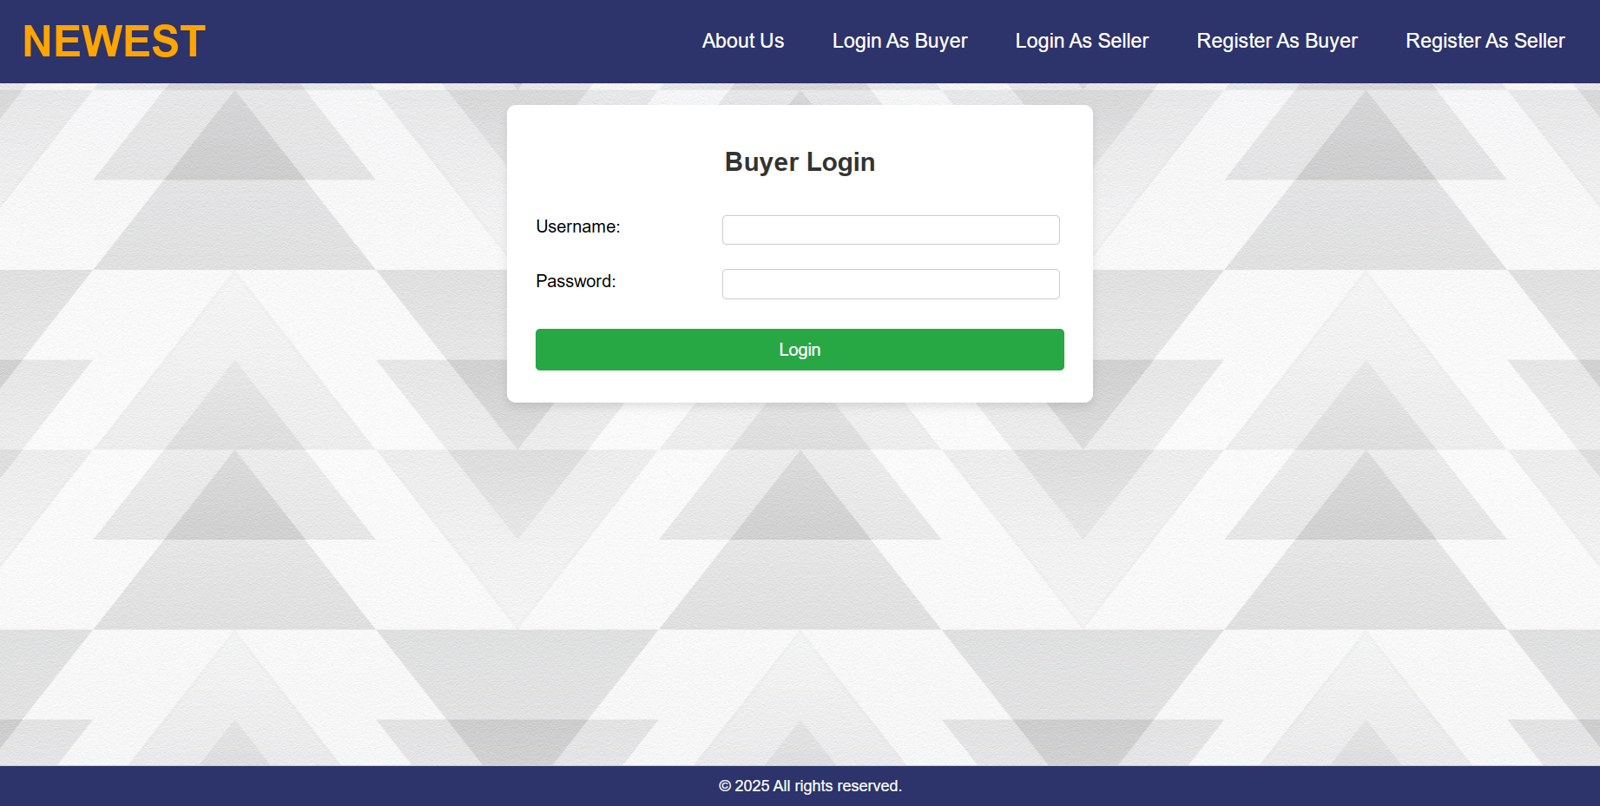

Slide 43
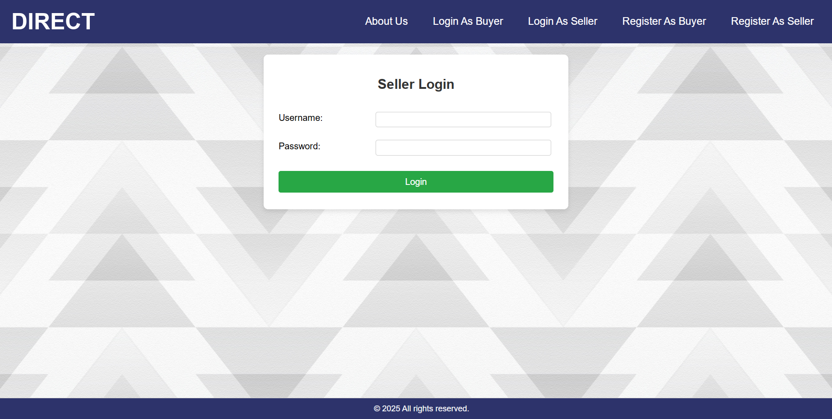

Slide 44
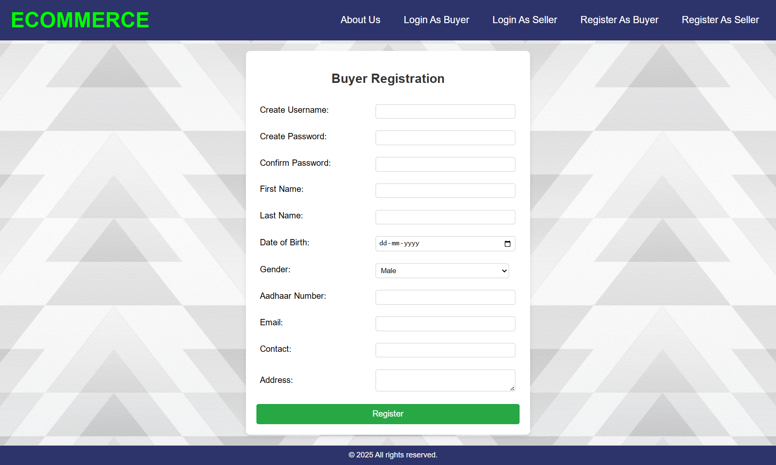

Slide 45
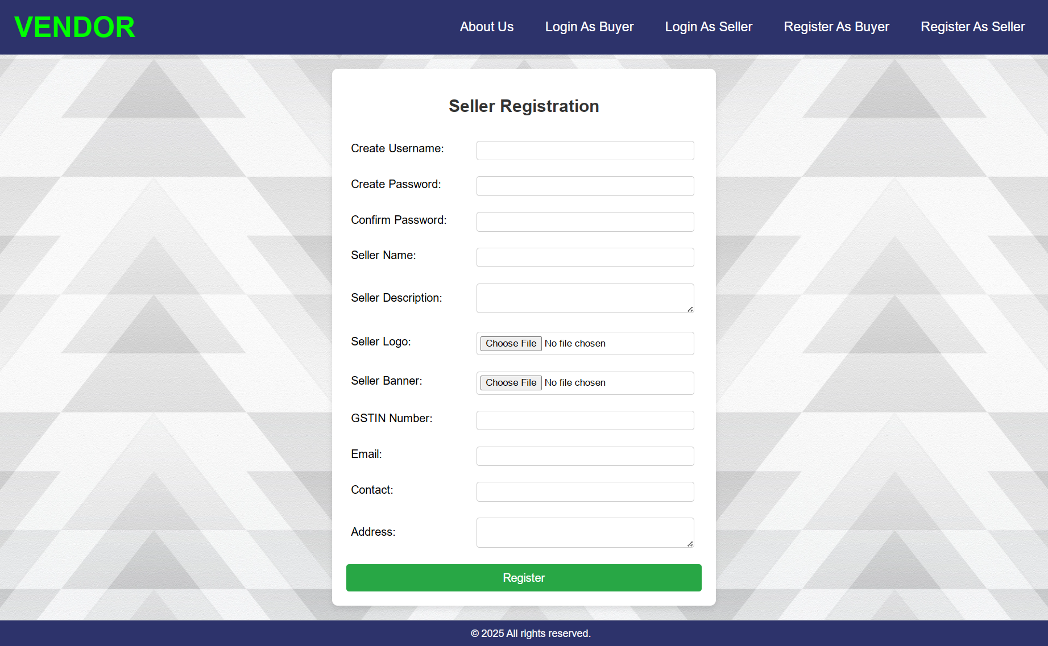

Slide 46
Buyer Side
Input Design

Slide 47
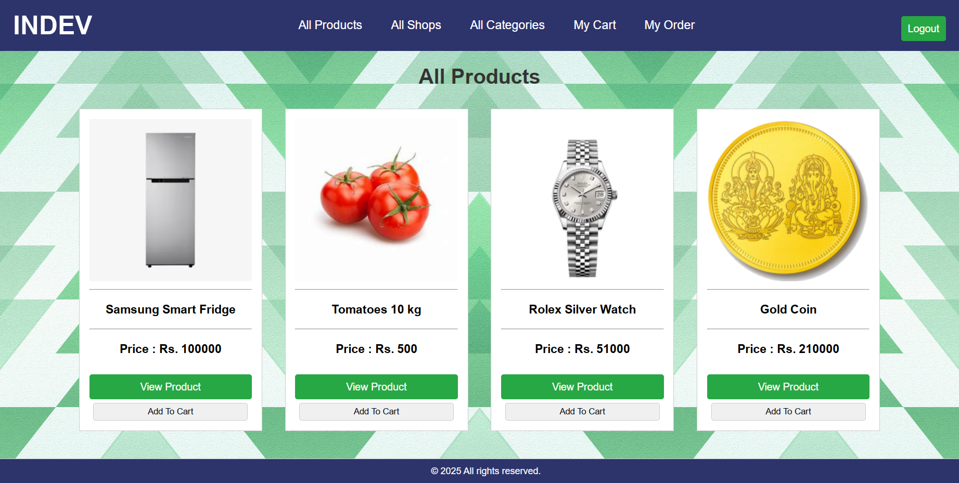

Slide 48
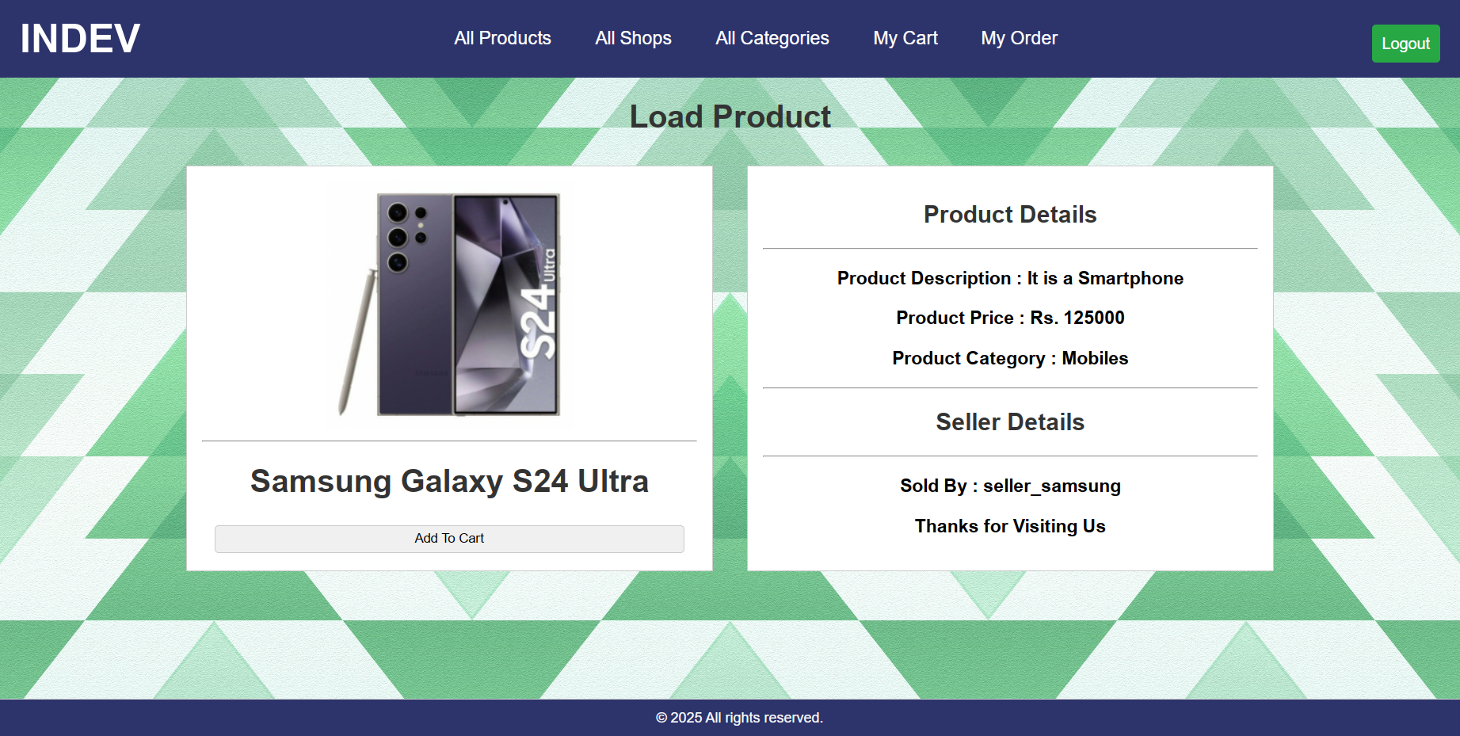

Slide 49
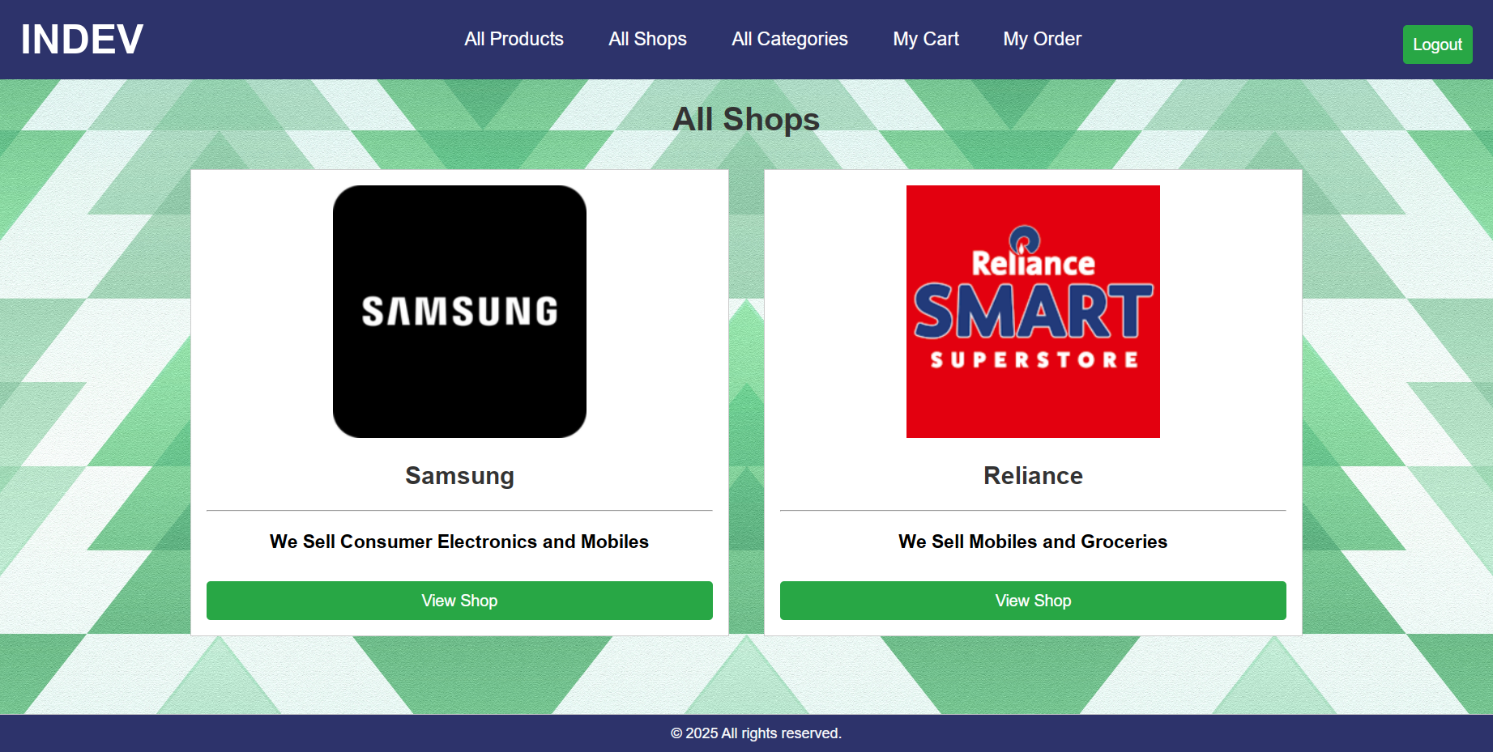

Slide 50
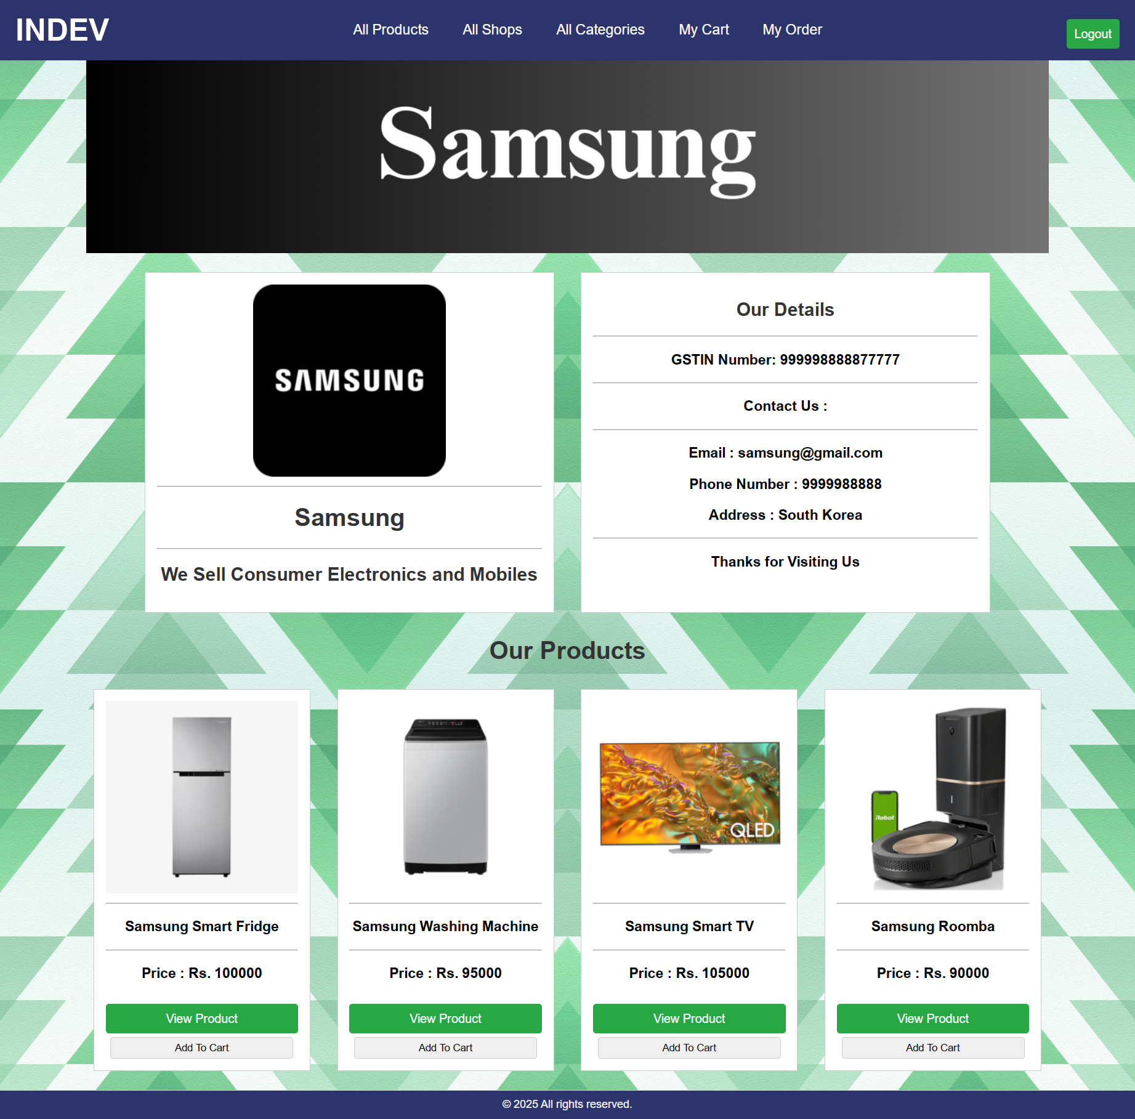

Slide 51
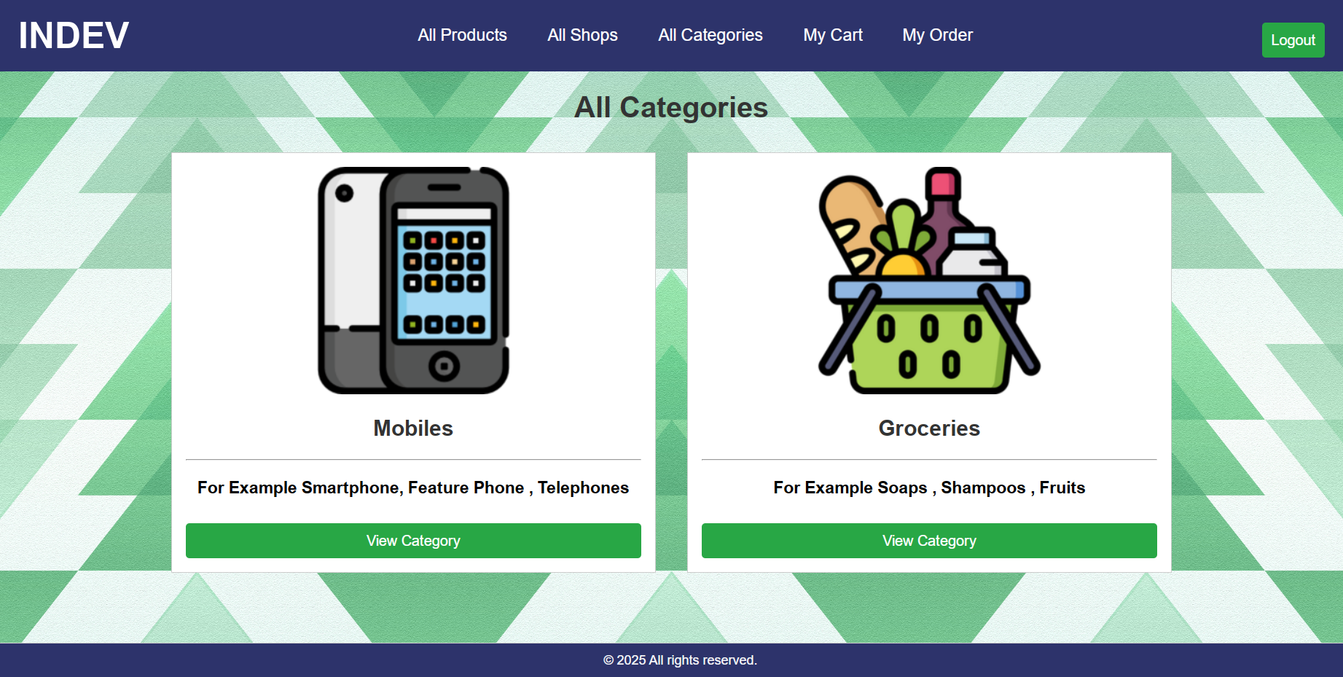

Slide 52
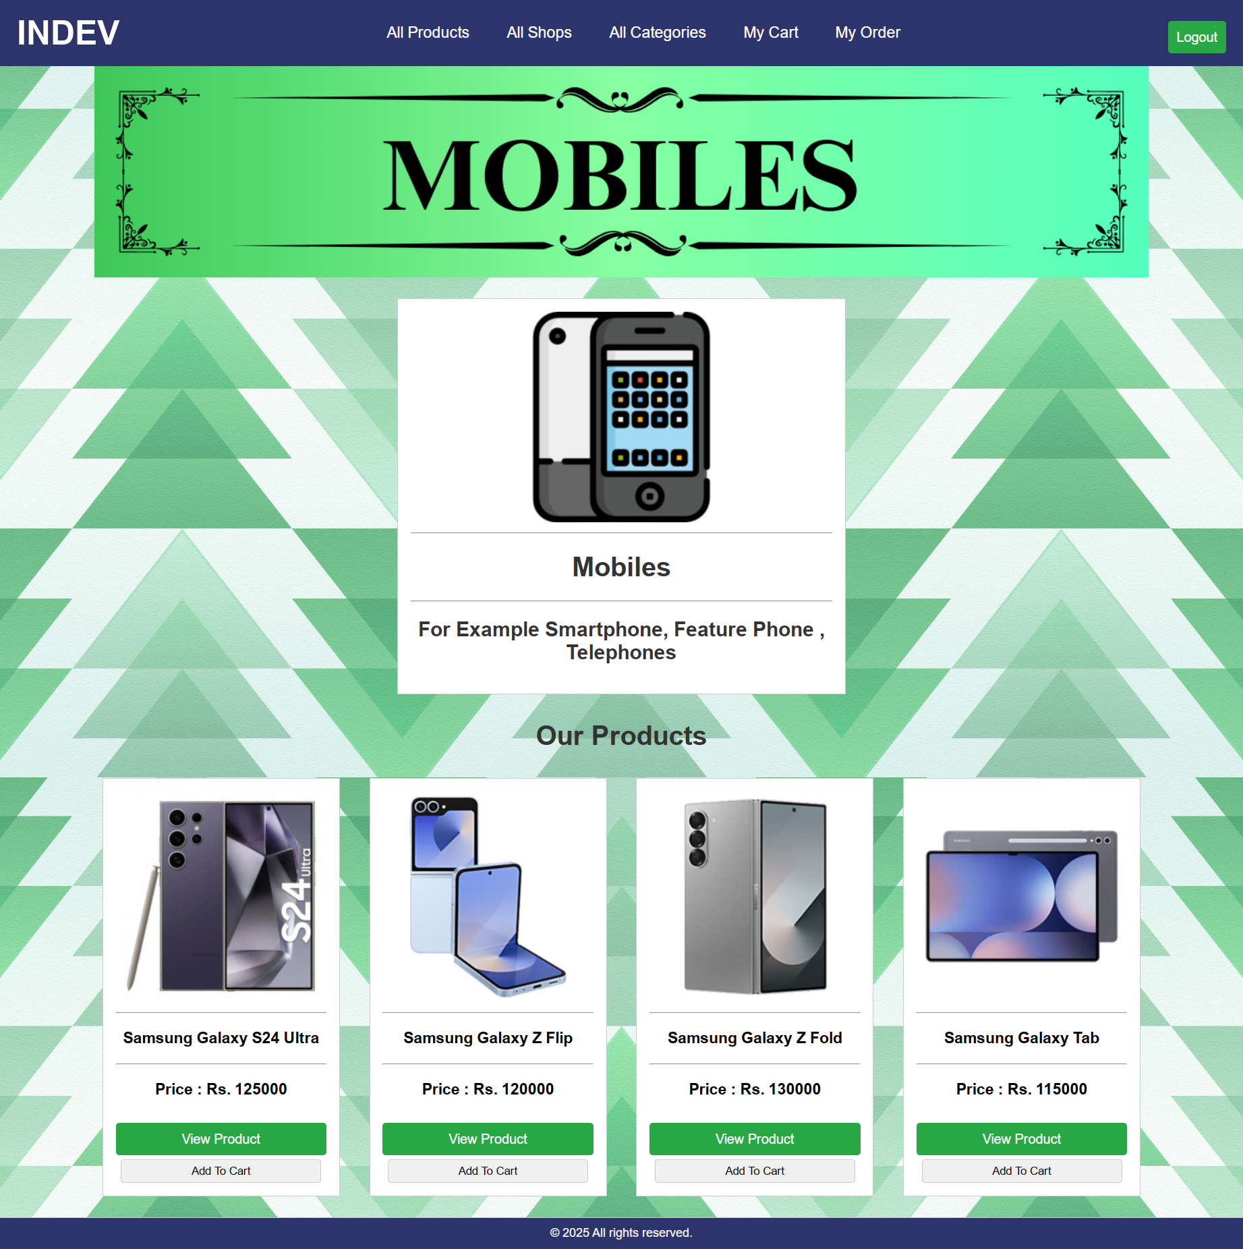

Slide 53
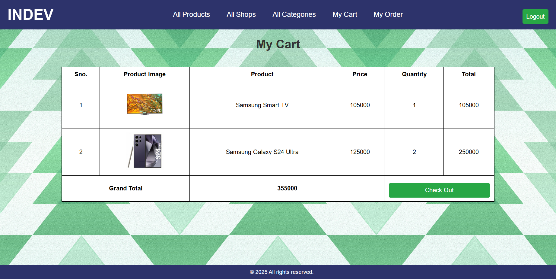

Slide 54
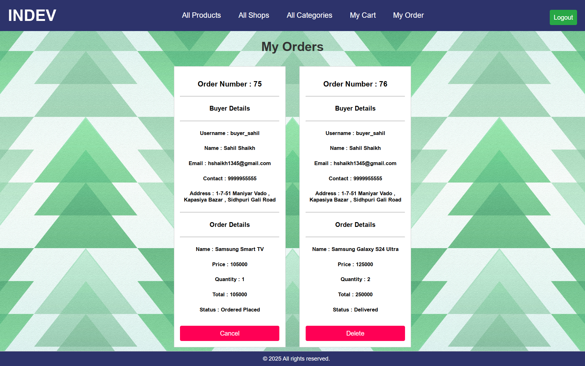

Slide 55
Seller Side
Input Design

Slide 56
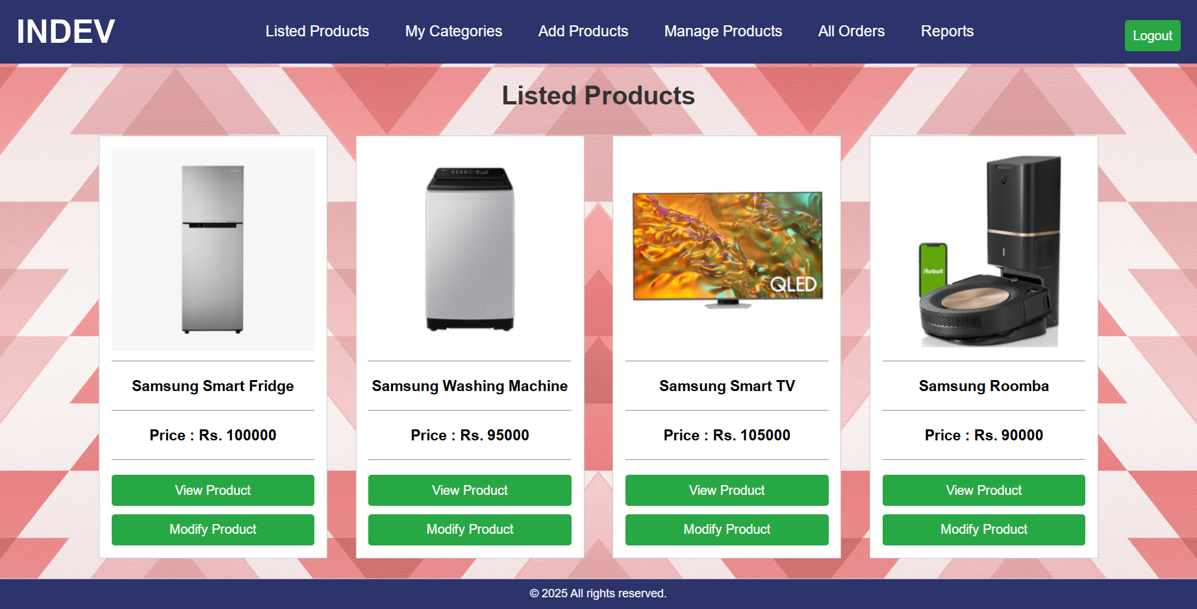

Slide 57
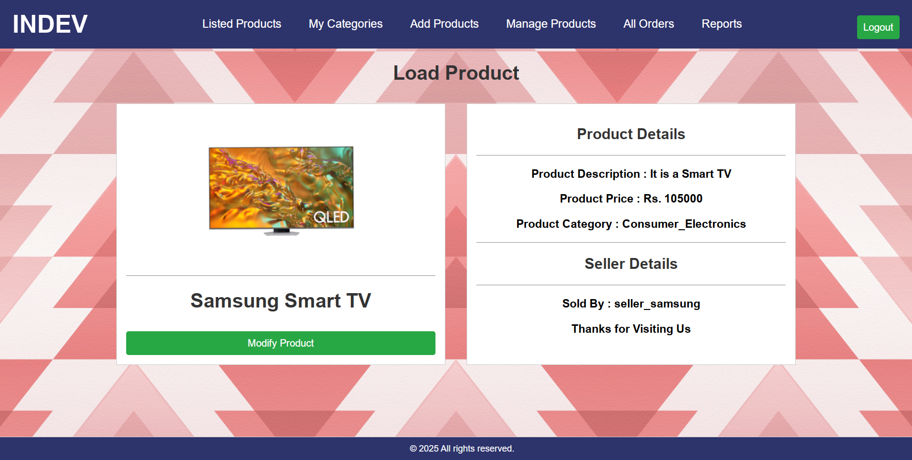

Slide 58
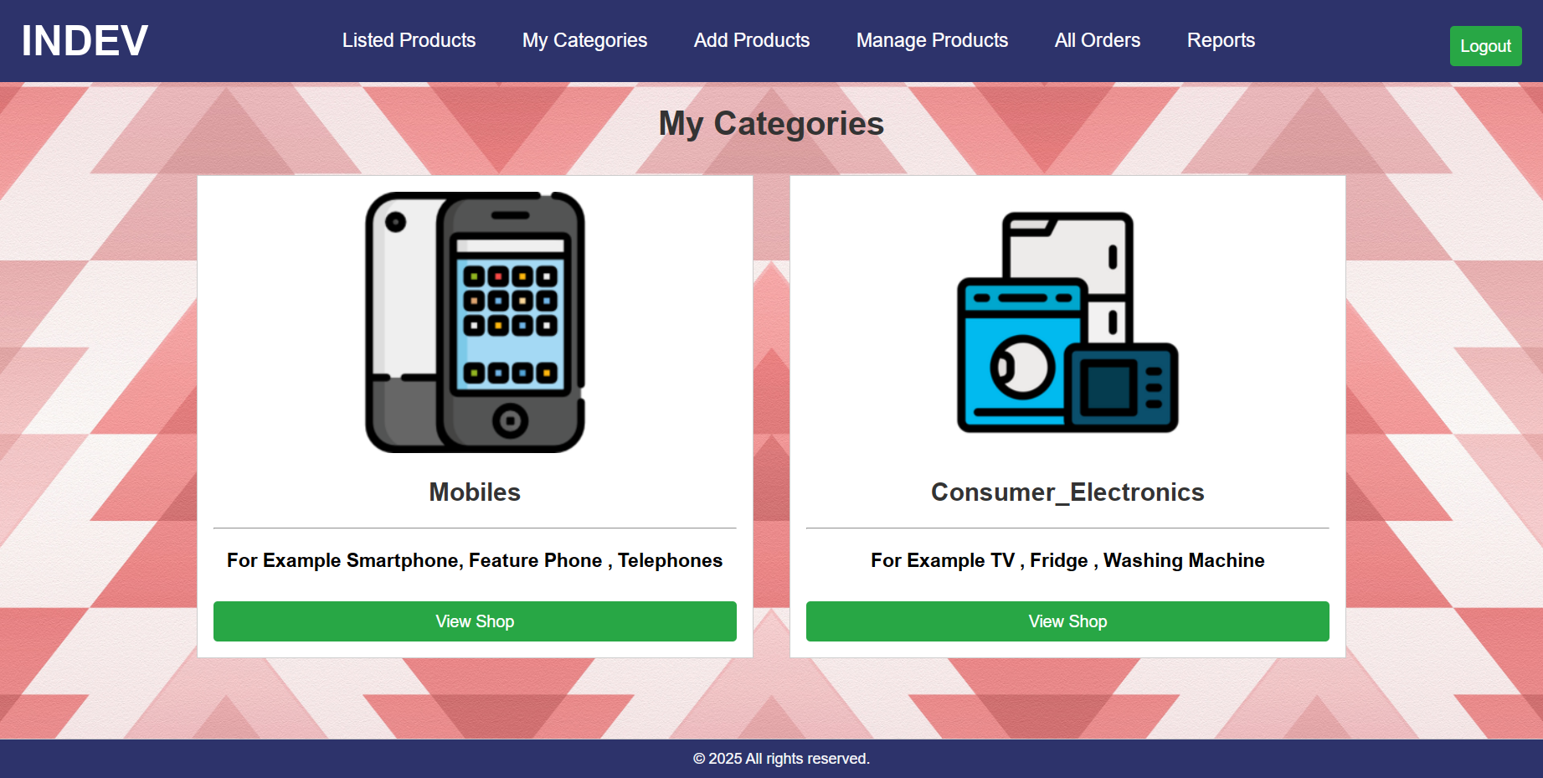

Slide 59
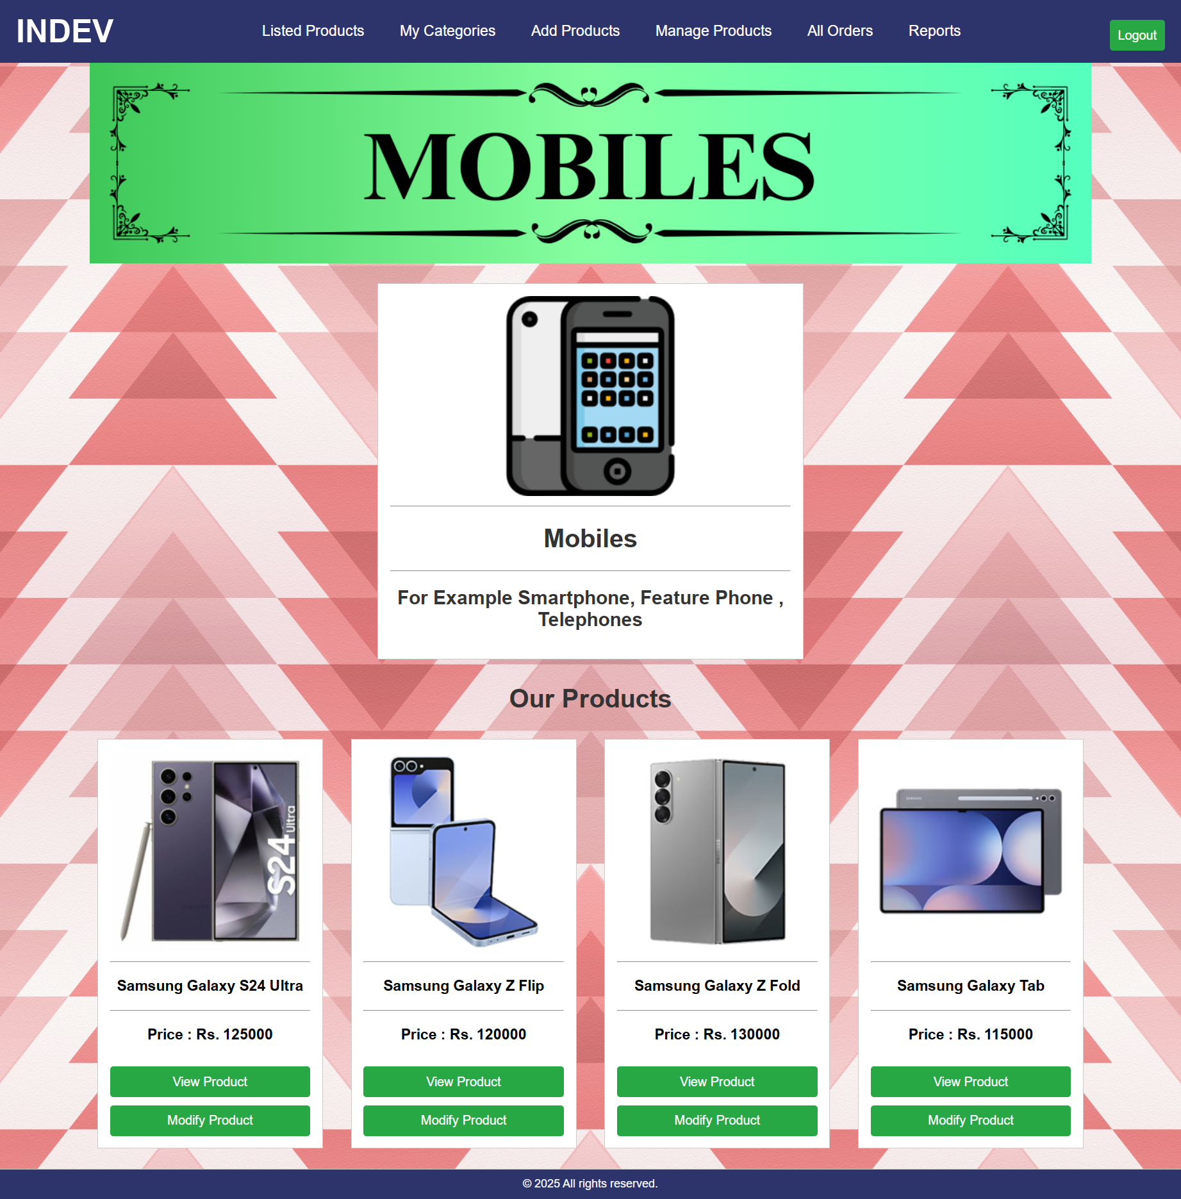

Slide 60
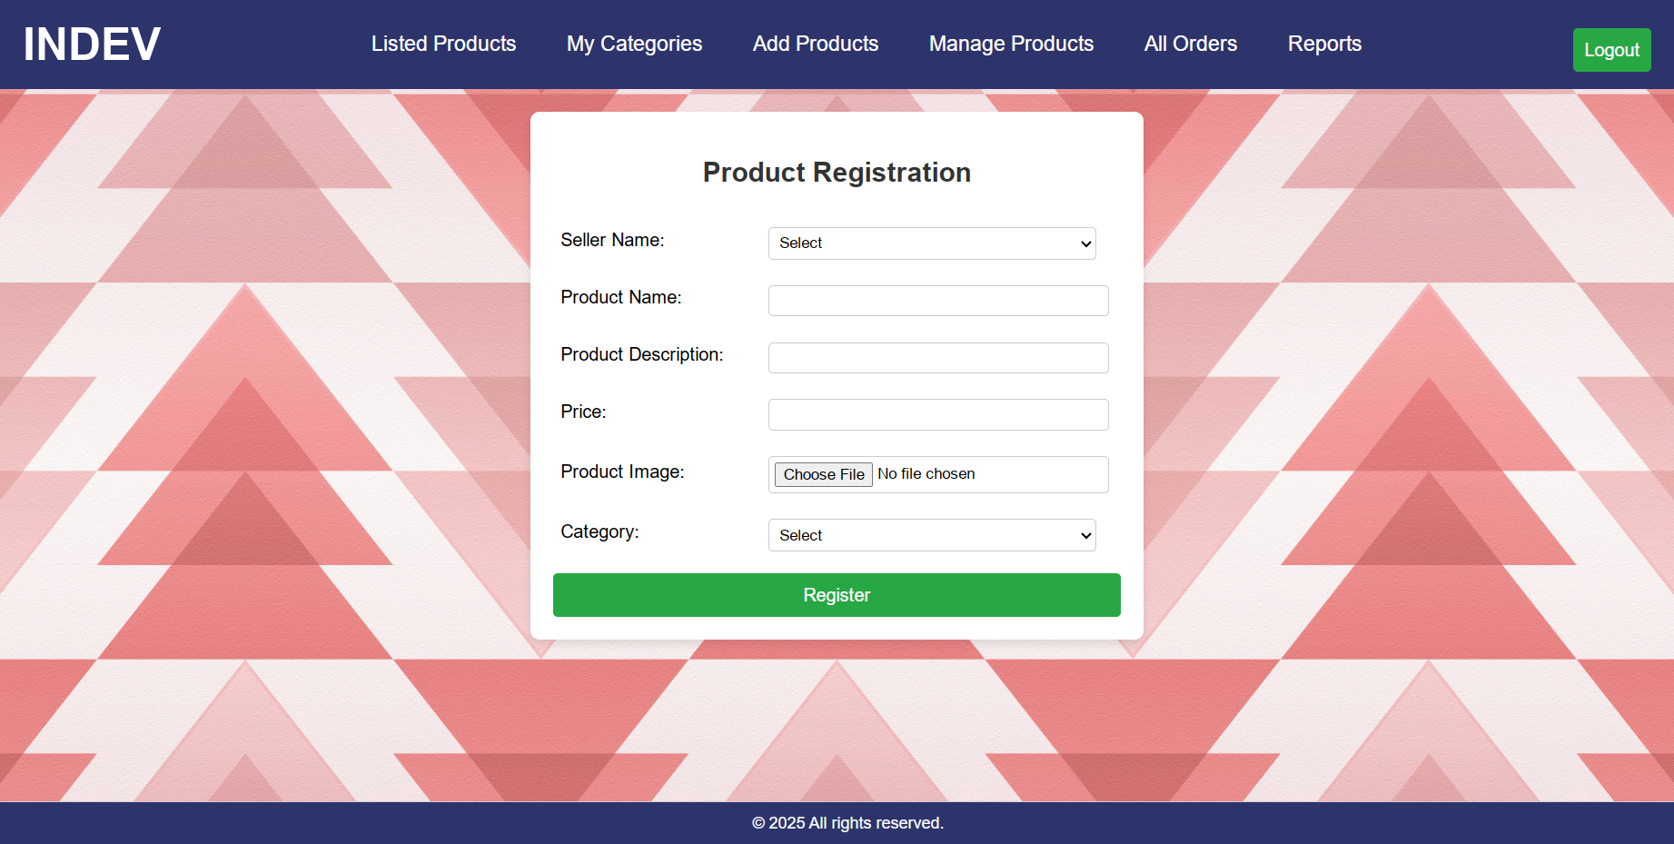

Slide 61
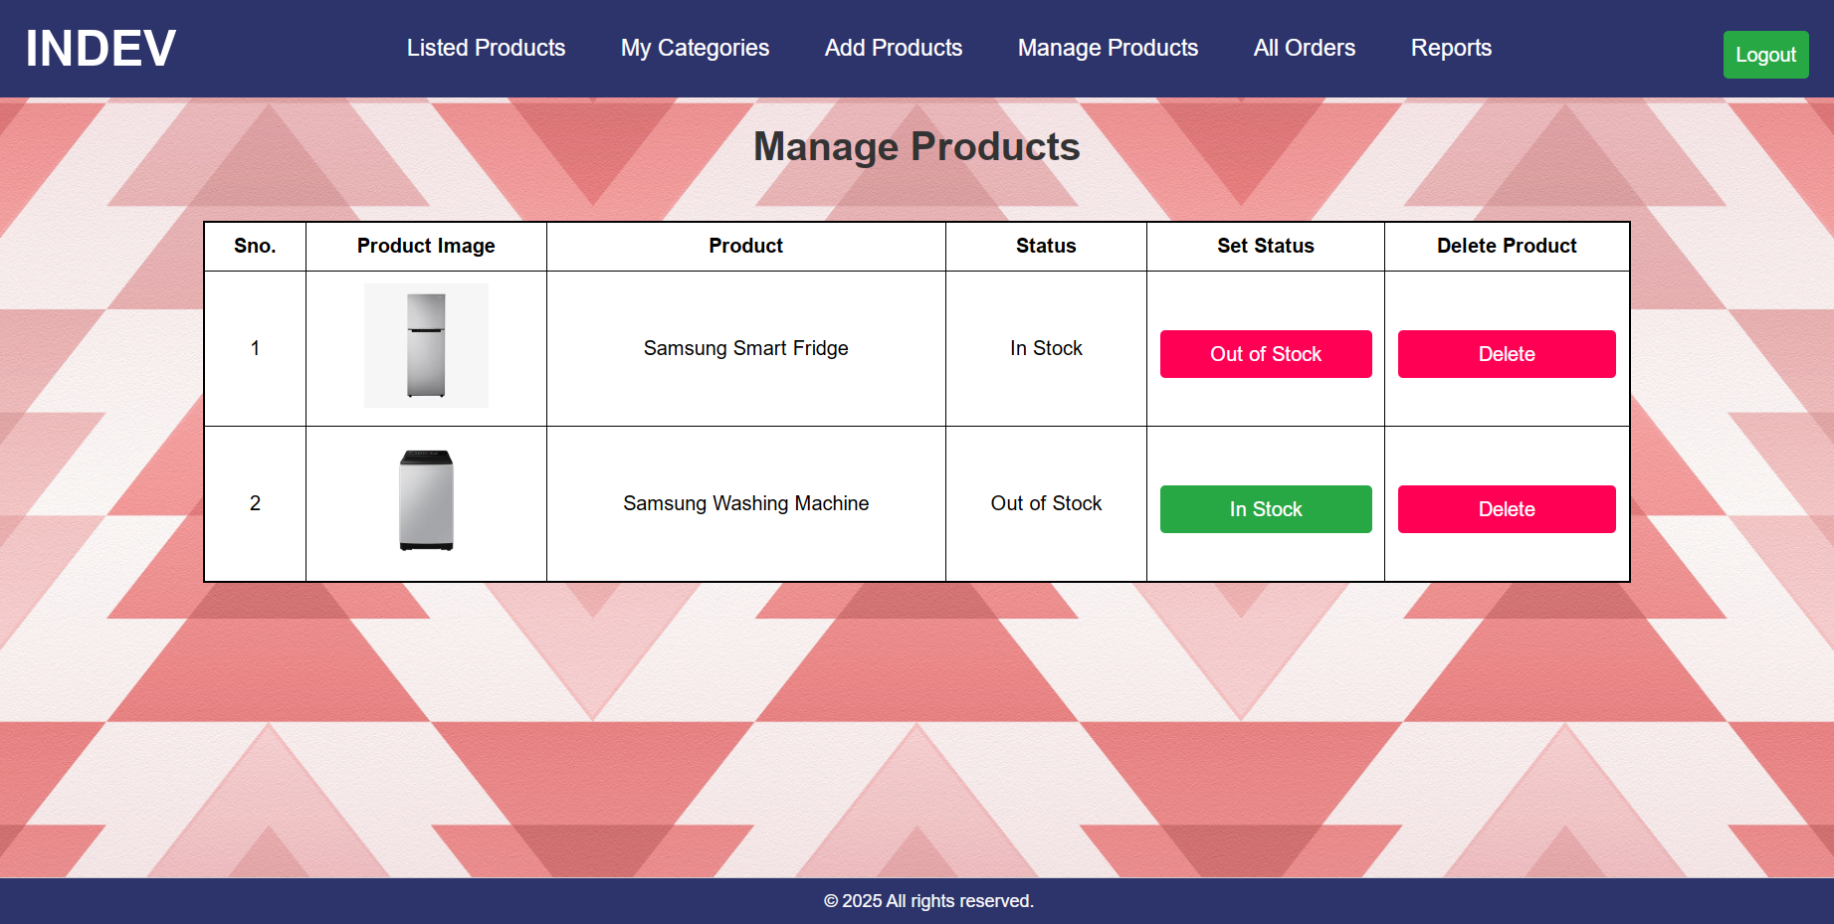

Slide 62
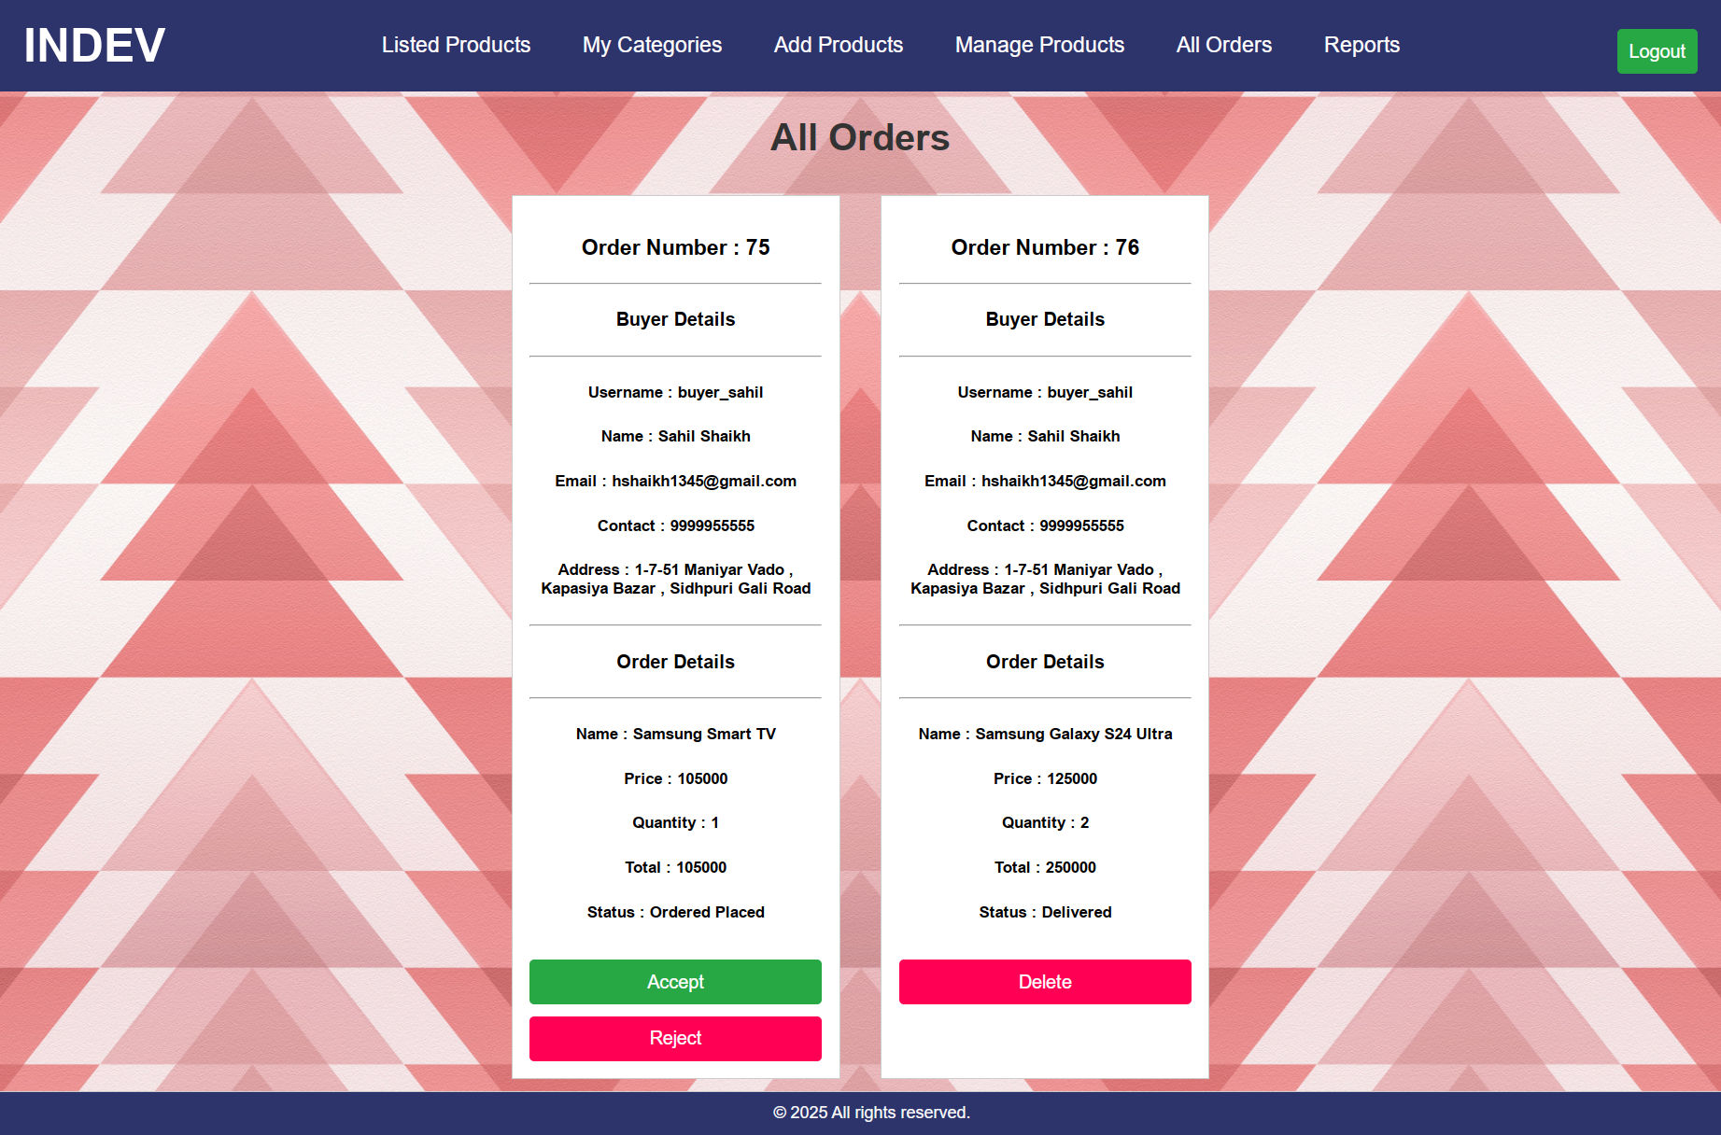

Slide 63
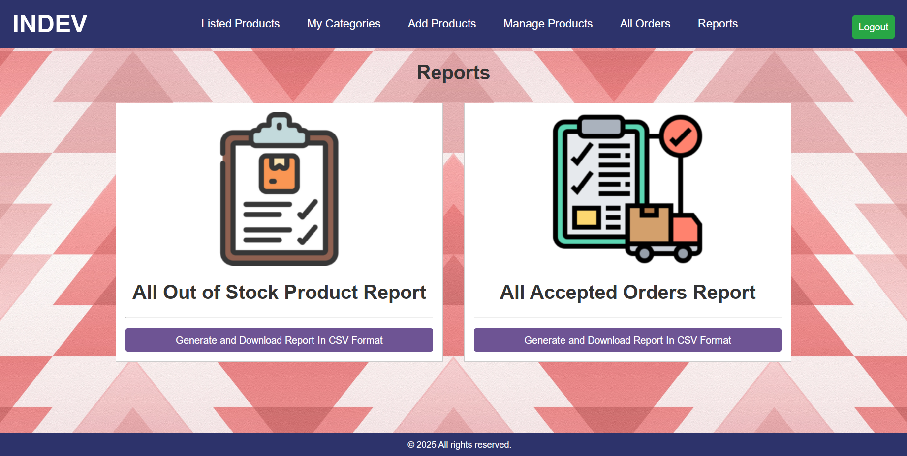

Slide 64
Admin Side
Input Design

Slide 65
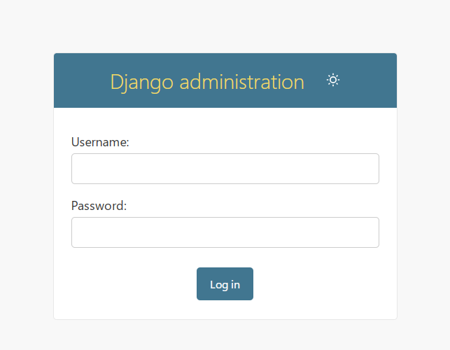

Slide 66
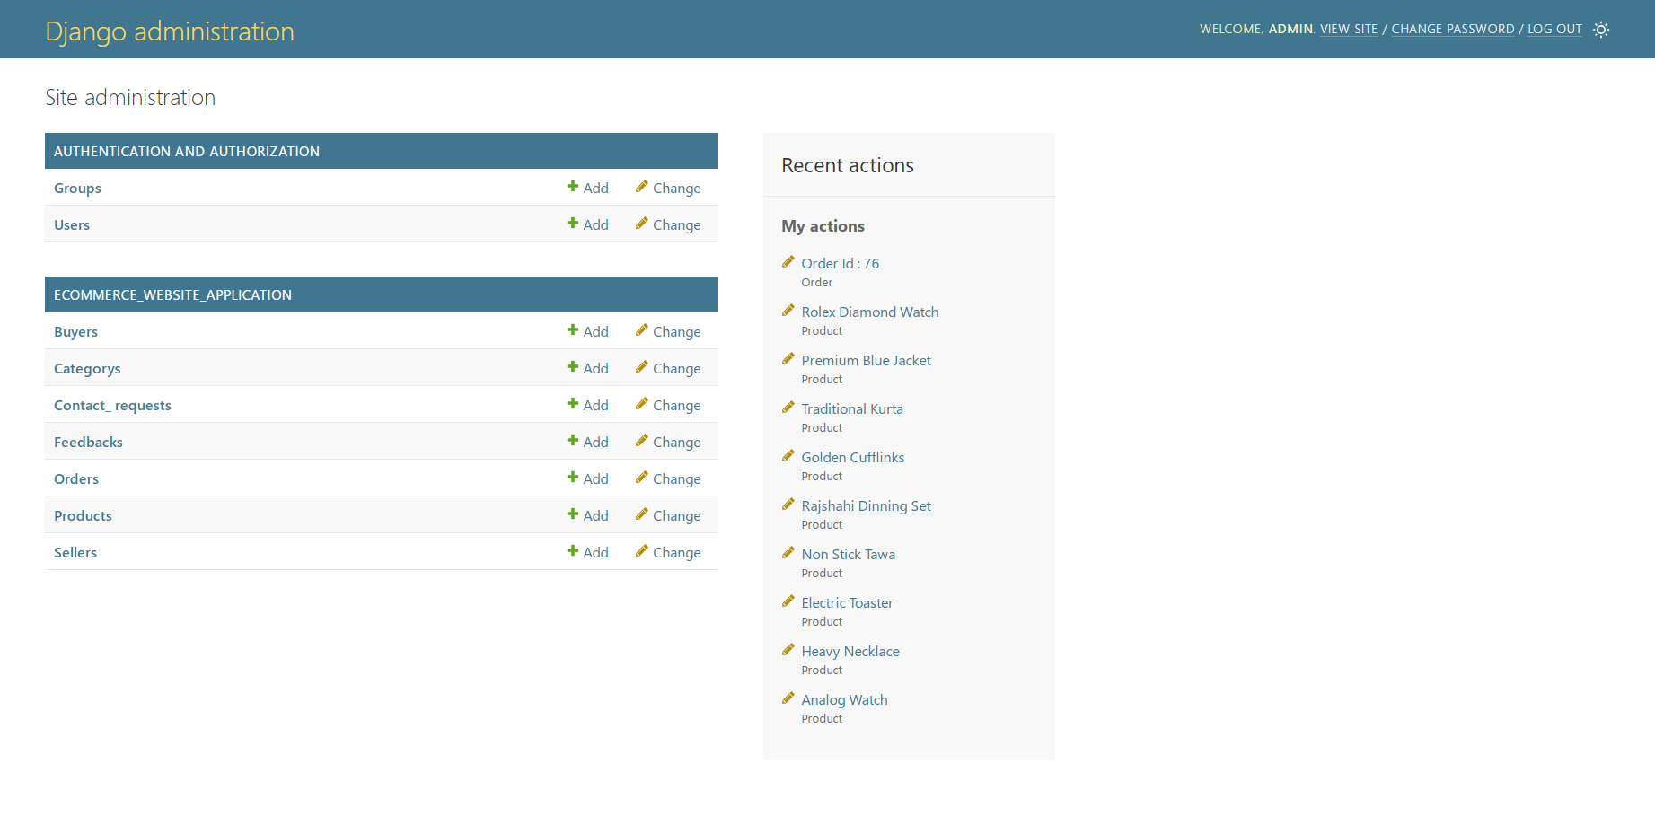

Slide 67
Future Enhancements
1. Payment Gateways – Modern payment gateway systems such as billdesk and razorpay can be added to provide support for online transactions.
2. Add Sale Function – Other functionalities such as creating a sale can be used to increase data traffic on the website.
3. Increase Filters – The number of filters can be increased in the near future.
4. Review and Rating System – A review system can be introduced to leave review on the purchased product by the buyer.
5. Profile Management – Profile management will allow users(buyer & sellers) to manage their own profile records and details.
6. Increase Responsiveness – The overall responsiveness of the website can be increased by using better animatronics and reactive css.
7. More Reports – We can integrate other python modules like Matplotlib to make better infographical and statistical reports

Slide 68
Bibliography
1. Django Reference – https://docs.djangoproject.com/en/5.1/
2. Learning – Geek for Geeks – https://www.geeksforgeeks.org/
W3 Schools – https://www.w3schools.com/django/index.php
3. Debugging – Stack Overflow – https://stackoverflow.com/questions
4. Other General Links – Google , Youtube , Wikipedia , Github , Udemy
5. General Utility Softwares – Canva , Word , Excel , Powerpoint
6. Chrome Extension – GoFullPage
7. Books Referred –

Slide 69
The Floor is Open For Questions
Thank You

